Slide 1
Autonomous Flight Systems Laboratory External Demo Sprint 1504
April 19, 2015

Slide 2
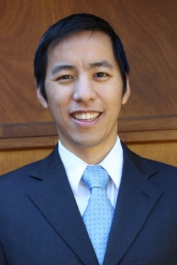
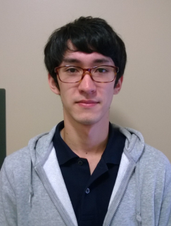
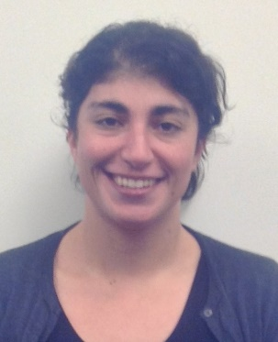

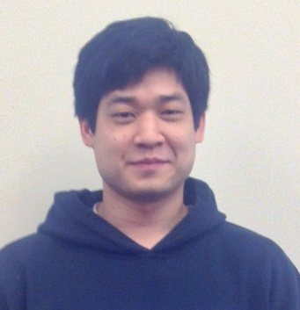
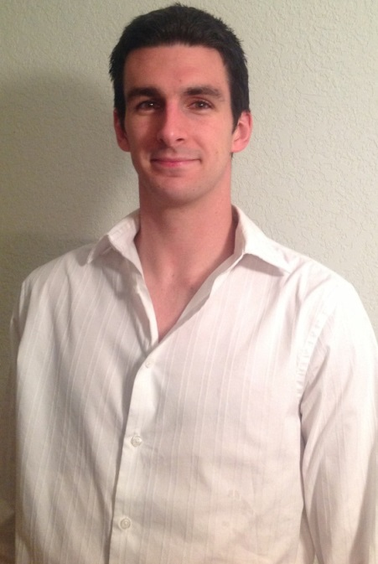
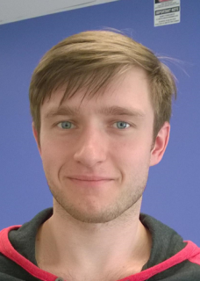
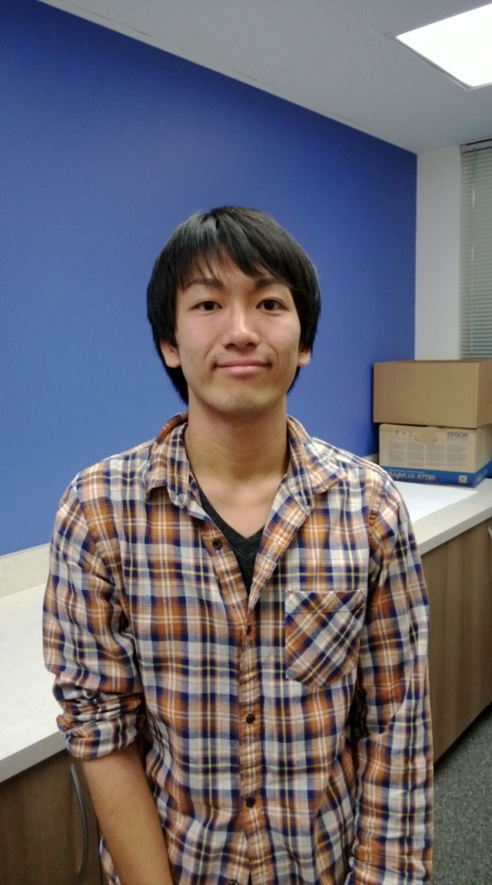
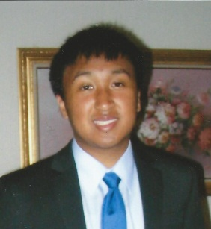
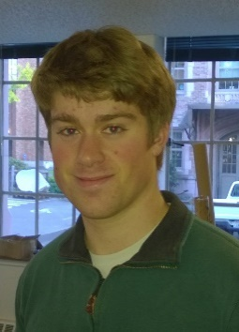
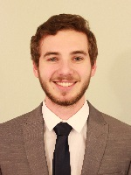
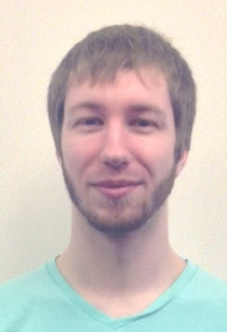
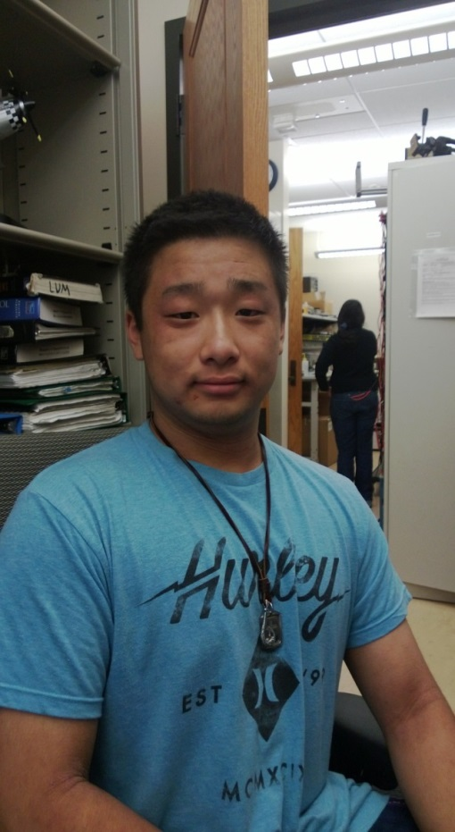
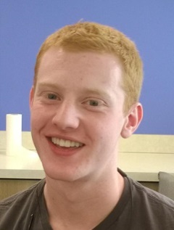
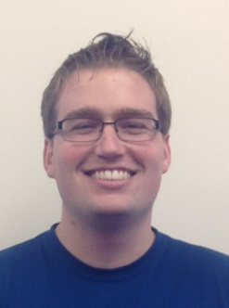
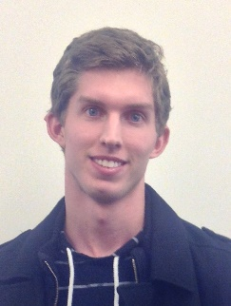
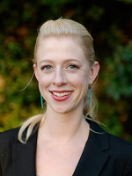
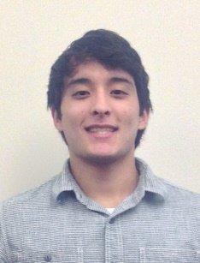
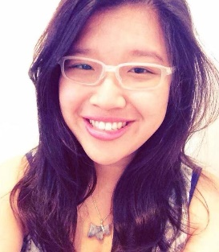
Team Introduction
Christopher Lum
Research Scientist
Dai Tsukada
Masters Student
Cory Hage
Masters Student
Hao Ruan
Masters Student
Jason Hung
Masters Student
Gage Winde
Masters Student
Al Creigh
Senior
Aleksandr Tereshchenkov
Senior
Keisuke Tsujita
Senior
Daniel Ablog
Senior
Jeremy Brenner
Senior
Brendan Doyle Wade
Senior
Bryan Ghahremani
Senior
Alex Summers
Senior
Justin Taft
Senior
Matthew Jones
Senior
Matthew Bolte
Senior
Sanjit Samra
Senior
Henry Qin
Junior
Ryan Valach
Junior
Alec Bueing
Junior
Brian Carpenter
Junior
Melanie Clark
Junior
Angel Rodriguez
Junior
Maxine Tan
Junior
University of Washington
2

Slide 3
Team Introduction
27 developers
1 research scientist
5 graduate students
21 undergraduates
Wide range of disciplines (AA, EE, ME, applied physics, etc.)
University of Washington
3

Slide 4
User Story Progression
Average of 3 points accepted per developer (15 hr/week).
Average of 5 points descoped per developer (~ 60% too ambitious)

Slide 5
Outline
Introduction (Chris Lum)
Systems overview (Al Creigh)
Software modifications
Mission Planner modifications (Keisuke Tsujita)
Pixhawk modifications (Gage Winde)
Orbit controller design (Dai Tsukada)
CONDOR camera system (Brendan Doyle Wade)
Image processing
Computer vision algorithms (Matthew Jones)
Image processing framework (Henry Qin, Ryan Valach, Justin Taft)
Aircraft simulation environment (Daniel Ablog)
Conclusions and discussion (Chris Lum)

Slide 6
Outline
Introduction (Chris Lum
Systems overview (Al Creigh)
Software modifications
Mission Planner modifications (Keisuke Tsujita)
Pixhawk modifications (Gage Winde)
Orbit controller design (Dai Tsukada)
CONDOR camera system (Brendan Doyle Wade)
Image processing
Computer vision algorithms (Matthew Jones)
Image processing framework (Henry Qin, Ryan Valach, Justin Taft)
Aircraft simulation environment (Daniel Ablog)
Conclusions and discussion (Chris Lum)

Slide 7
Overview
Aircraft
3DR contact
Mission Planner
Communicates with a/c. Passes flight information to DF and receives distance to target from DF

Slide 8
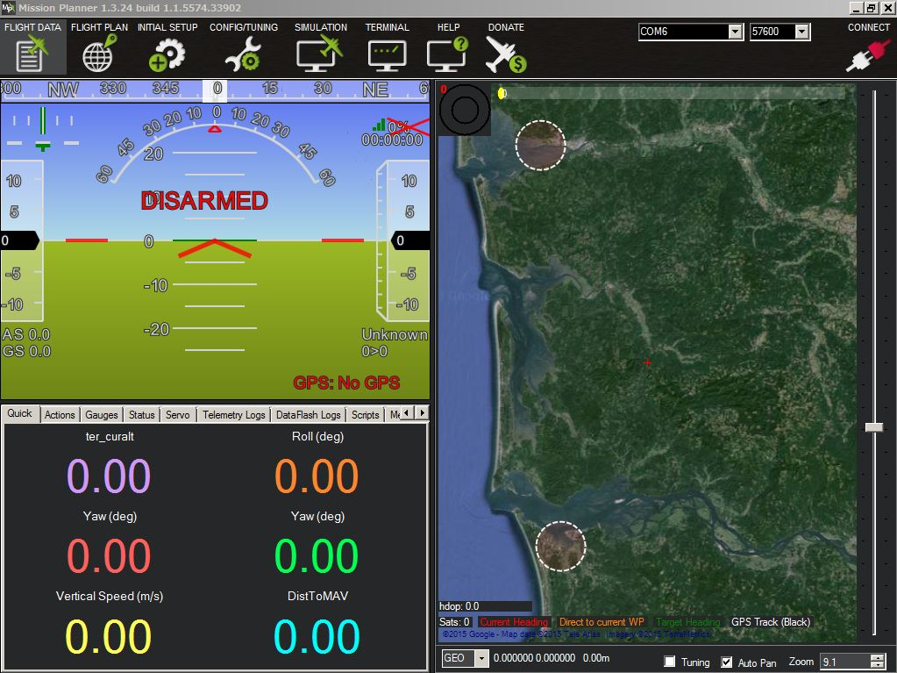
Mission Planner
Notes:
Mission Planner is the ground station we use to control UAVs. It has some functions which allow us to plan a mission, change flight modes, and so on. Although these functions are great and very useful for a certain extent, they are not the best for our missions so we need to add some functions to the mission planner

Slide 9
Functions to be added
Extract state information to be used by other applications
Customized flight modes
Upload the parameters/commands from the customized flight modes to autopilot
Add user interface of the customized flight modes
Current Progress
Notes:
Several functions which needs to be added are listed here. We want to access the state information of the aircraft by other applications for various purposes, like visual anchoring.
Also, we want to add one or more flight modes dedicated to our mission and send the required information to the aircraft.
Along with adding flight modes, we also would like to have an user interface so that it is easy to use.
Currently, we accomplished to extract Euler angles of the aircraft and write them on a text file.

Slide 10
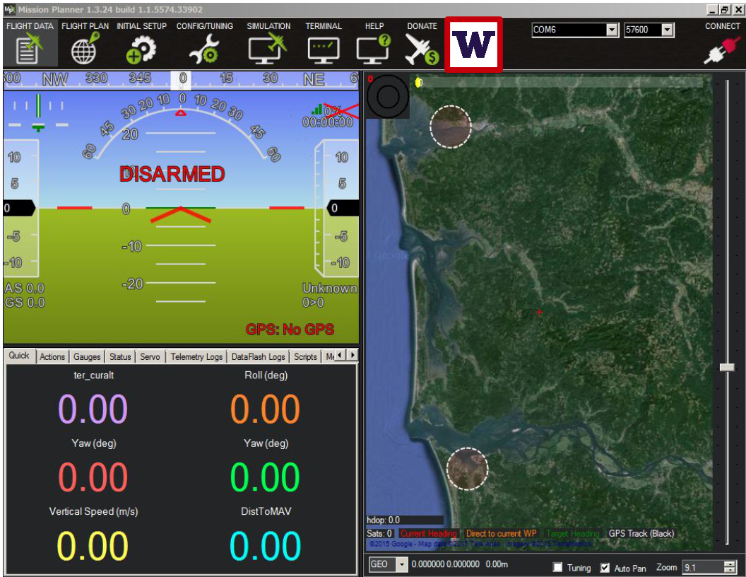
Mission Planner with UW flight modes
UW Flight Mode 1
UW Flight Mode 2
UW Flight Mode 3
Parameter 1
Parameter 2
Parameter 3
Parameter 4
Parameter 5
Upload to aircraft
……
Notes:
In the future, we are going to have a UW tab on the top of Mission Planner. Here, we will be able to change the flight modes to the customized ones. If the flight mode requires parameter inputs, we will be capable of changing them. Then we will upload information necessary to complete a mission to aircraft.

Slide 11
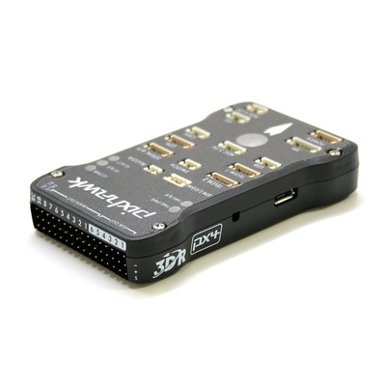
PixHawk Modification
Today:
Modify PixHawk firmware without impacting current features
Send control signal to servos
Retrieve data from sensors
Take commands from ground station
Near Future:
Use what we learn to build a custom flight mode into the PixHawk firmware
Include orbit controller
3D Robotics Inc.

Slide 12
Outline
Introduction (Chris Lum
Systems overview (Al Creigh)
Software modifications
Mission Planner modifications (Keisuke Tsujita)
Pixhawk modifications (Gage Winde)
Orbit controller design (Dai Tsukada)
CONDOR camera system (Brendan Doyle Wade)
Image processing
Computer vision algorithms (Matthew Jones)
Image processing framework (Henry Qin, Ryan Valach, Justin Taft)
Aircraft simulation environment (Daniel Ablog)
Conclusions and discussion (Chris Lum)

Slide 13
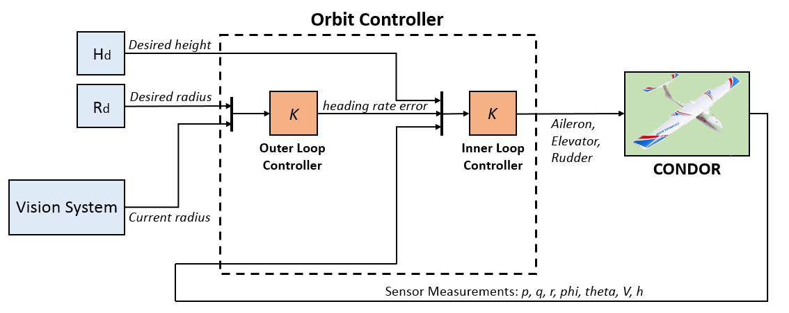
Orbit Controller for Visual Anchoring
Orbit controller is composed of two sub-controllers
Inner loop controller
Controls the actuators and stabilize the aircraft in the orbit based on the sensor measurements and outer loop controller signal
Outer loop controller
Computes the heading rate error from operator/vision system information

Slide 14
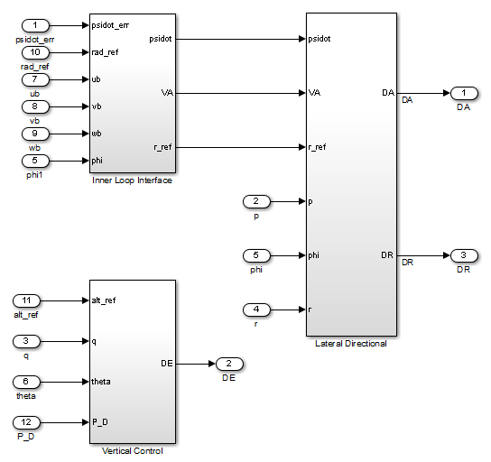
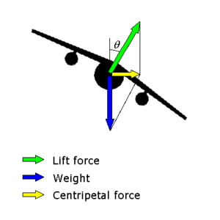
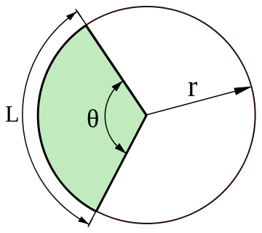
Inner Loop Controller
Inner Loop Controller
Converts radius input into heading rate command, which to be used in lateral axis
Uses bank angle as reference signal and execute coordinated turn
Error command from orbit deviation used to correct bank angle
Takes altitude input to control vertical axis

Slide 15
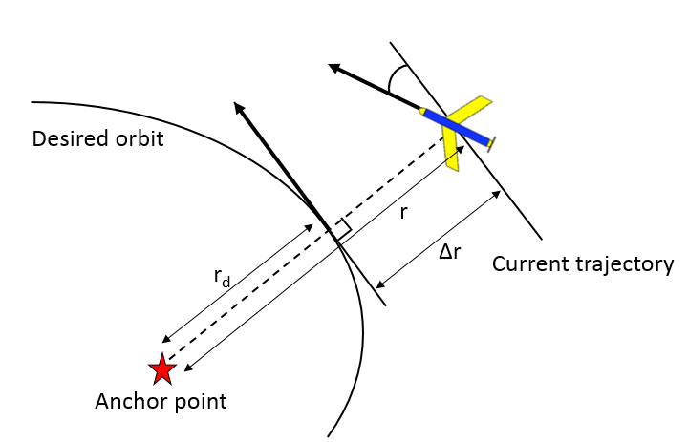
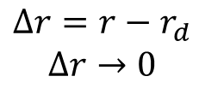
Outer Loop Controller
Outer Loop Controller
Listens to Vision System output to determine the cross track error
Computes the heading rate error signal to correct desired path
Want to reduce the radius error caused by the disturbances.
Feedback the radius error to the controller, and output the required heading rate to fix the flight path.
$$∆r=r−r_{d}$$
$$∆r→0$$

Slide 16
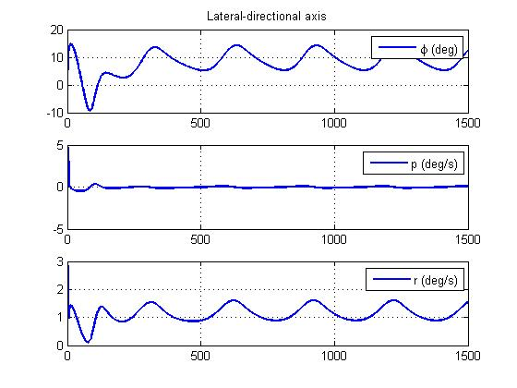
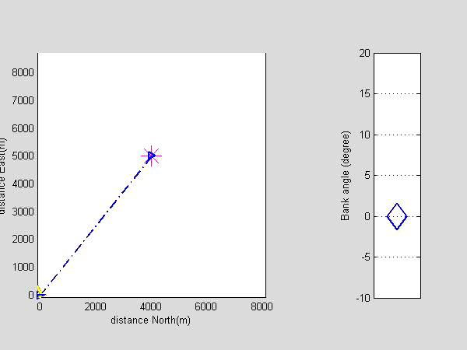
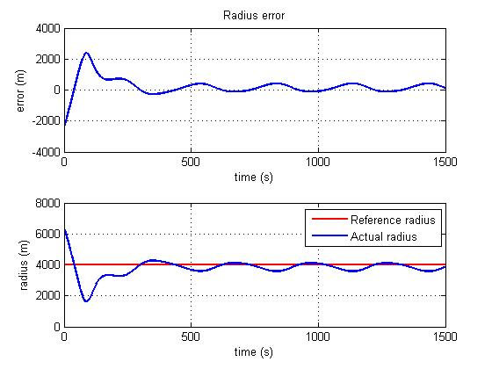
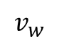
Simulation Performance
Example Case:
Constant wind disturbance
North wind: 10 m/s (~20knot)
West wind: 10 m/s (~10knot)
Desired orbit: 4000m
$$v_{w}$$

Slide 17
Outline
Introduction (Chris Lum
Systems overview (Al Creigh)
Software modifications
Mission Planner modifications (Keisuke Tsujita)
Pixhawk modifications (Gage Winde)
Orbit controller design (Dai Tsukada)
CONDOR camera system (Brendan Doyle Wade)
Image processing
Computer vision algorithms (Matthew Jones)
Image processing framework (Henry Qin, Ryan Valach, Justin Taft)
Aircraft simulation environment (Daniel Ablog)
Conclusions and discussion (Chris Lum)

Slide 18
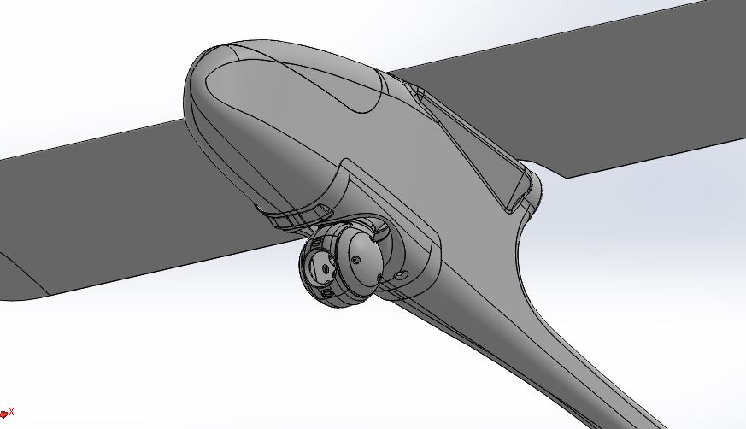
3D Printed Camera Gimbal

Slide 19
Purpose and Features
Mount a high resolution camera to Skywalker 1900 platform
360 degrees pan, 100 degrees tilt
Deploy during flight and retract for landing
3D printing enabled a compact and rugged design

Slide 20
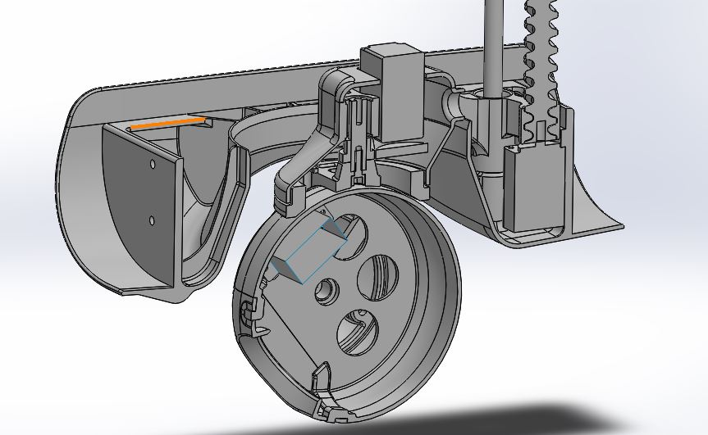
Problem Statement

Slide 21
Subcomponents
Receiver
PWM stepper motor driver
Battery eliminator circuit
Servo range extender
2 digital servos (pan and tilt)
Nema 8 unipolar stepper motor (retract)

Slide 22
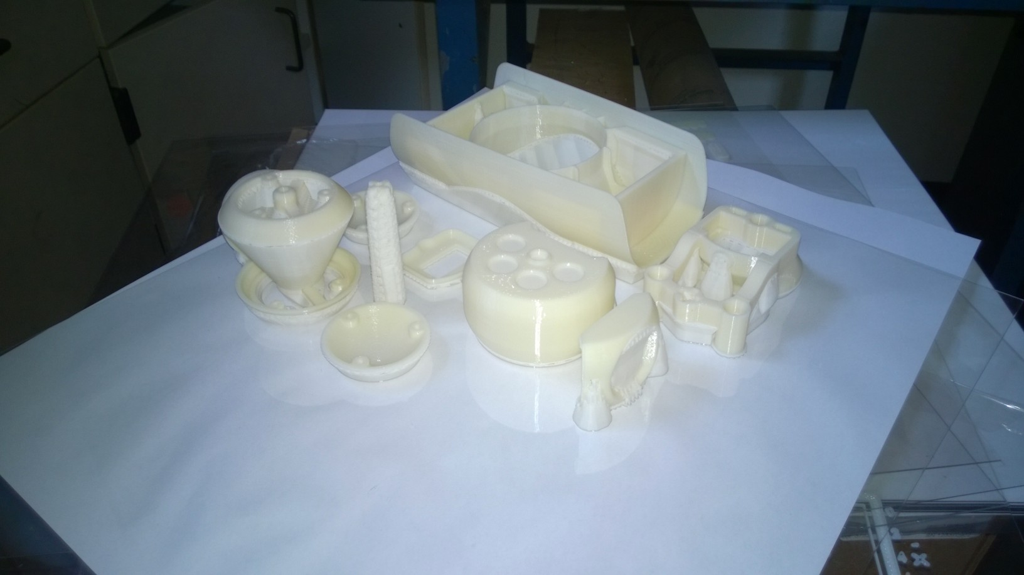
Problem Statement

Slide 23
Outline
Introduction (Chris Lum
Systems overview (Al Creigh)
Software modifications
Mission Planner modifications (Keisuke Tsujita)
Pixhawk modifications (Gage Winde)
Orbit controller design (Dai Tsukada)
CONDOR camera system (Brendan Doyle Wade)
Image processing
Computer vision algorithms (Matthew Jones)
Image processing framework (Henry Qin, Ryan Valach, Justin Taft)
Aircraft simulation environment (Daniel Ablog)
Conclusions and discussion (Chris Lum)

Slide 24
Problem Statement
Determine the center pixel of an object of interest from the raw image for use in distance calculation
Two main computer vision algorithms being considered:
SURF feature detection
Color thresholding and filtering
Assumptions:
The object of interest stays in the frame at all sampled times
The object is distinct from its environment to the point that color filtering works
Raw Image from Data Fusion
Pixel of Interest Algorithm
Pixel of Interest

Slide 25
SURF Features Algorithm
Load the first image and run SURF detection
The SURF detection algorithm determines the points in the image with interesting features, usually edges
Run SURF detection on the next image, then determine what features the two images have in common
Use a statistical analysis to remove outliers
Draw a boundary around the area with the highest feature density

Slide 26
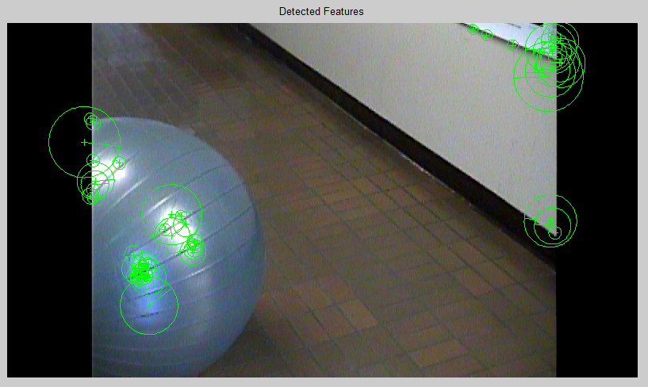
Algorithm Summary
Step 1:
Load the first image and run SURF detection
The SURF detection algorithm determines the points in the image with interesting features, usually edges

Slide 27
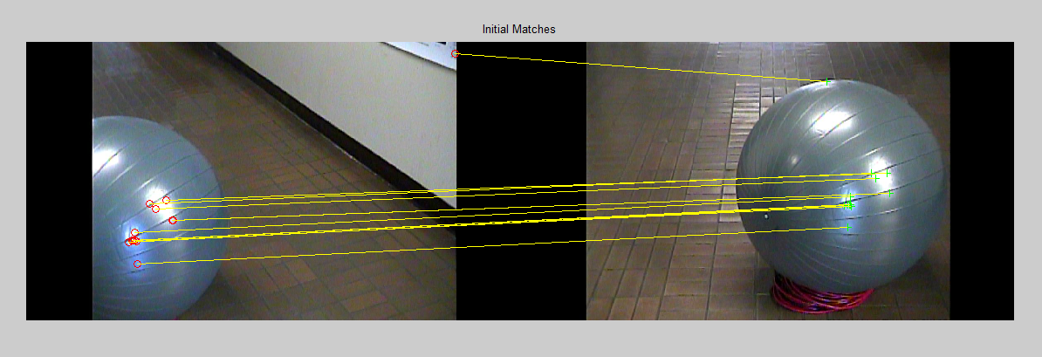
Algorithm Summary
Step 2:
Run SURF detection on the next image, then determine what features the two images have in common

Slide 28
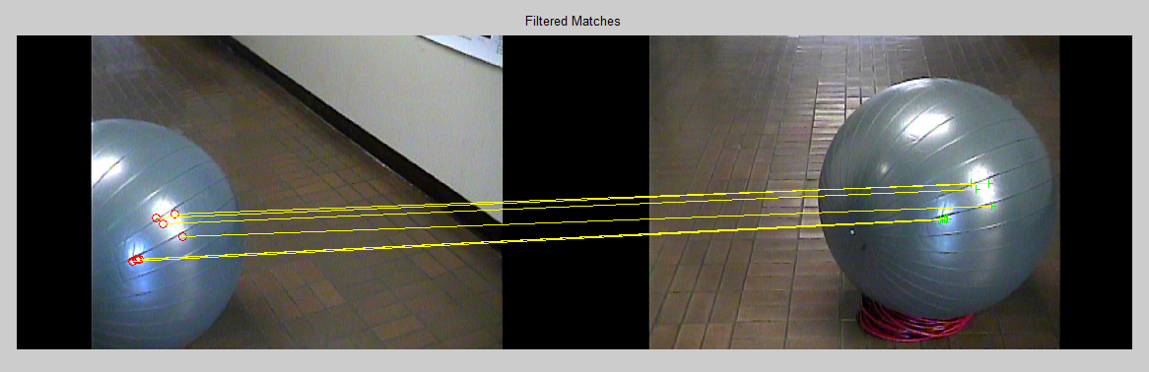
Algorithm Summary
Step 3:
Use a statistical analysis to remove outliers

Slide 29
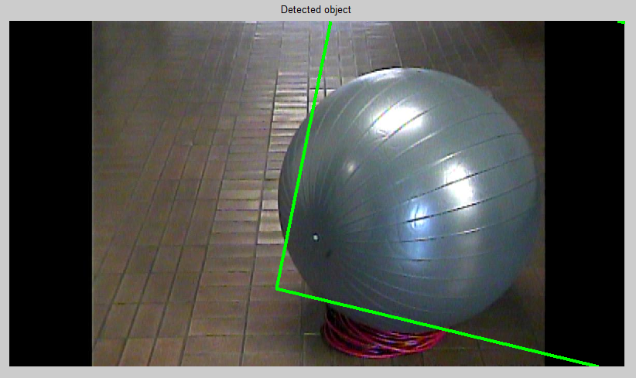
Algorithm Summary
Step 4:
Draw a boundary around the area with the highest feature density

Slide 30
Pros and Cons of SURF Features
Pros and Cons of SURF Feature Detection:
Pros:
Robust
Object of interest does not have to be a distinct color from the environment
Cons:
Slow runtime
Can detect the wrong object if other objects have more features

Slide 31
Color Thresholding Algorithm
Load the image and select area of interest, then choose the tolerance band for the color threshold
Tolerance is ideally based upon the amount of color contrast between the object of interest and the surrounding environment
Determine the color properties of the area of interest and apply the color threshold
Determine areas of the red, green, and blue channels of the next, new image
Select only the areas in which the required red, green, and blue thresholds are met
Find the center of the area

Slide 32
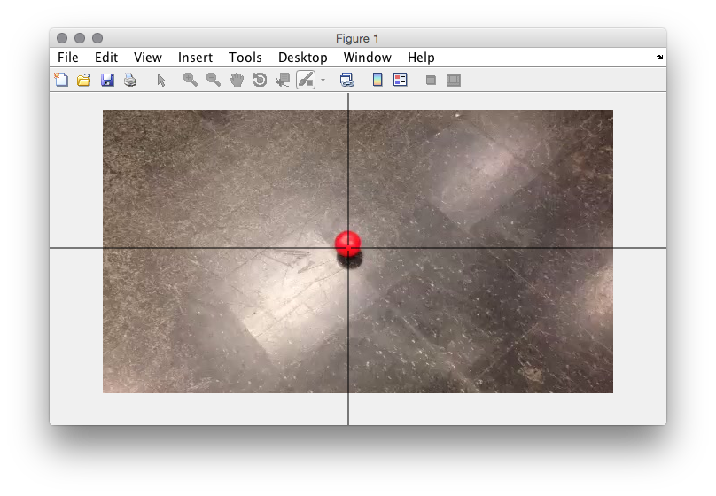
Algorithm Summary
Step 1:
Load the image and select area of interest and choose the tolerance
Tolerance is ideally based upon the amount of color contrast between the object of interest and the surrounding environment

Slide 33
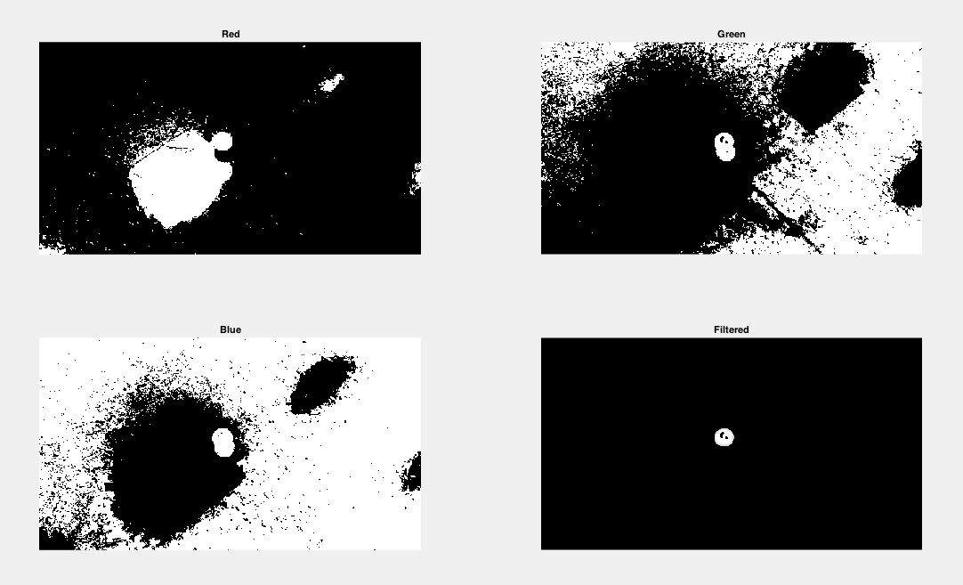
Algorithm Summary
Step 2:
Determine the color properties of the area of interest and apply the threshold
Determine areas of the red, green, and blue channels of the next, new image
Select only the areas in which the required red, green, and blue thresholds are met

Slide 34

Algorithm Summary
Step 3:
Find the center of the object, and repeat for the next image

Slide 35
Pros and Cons of Color Thresholding
Pros and Cons of Color Thresholding:
Pros:
Fast runtime
Cons:
Object of interest must be distinct from the environment

Slide 36
Future Work
Future Test Considerations:
Situations where there is less color contrast
Can tightening the tolerance negate the lessened contrast?
Situations where there are other objects of the same color as the object of interest
Implementing color filters in conjunction with SURF feature detection as a failsafe

Slide 37
Outline
Introduction (Chris Lum
Systems overview (Al Creigh)
Software modifications
Mission Planner modifications (Keisuke Tsujita)
Pixhawk modifications (Gage Winde)
Orbit controller design (Dai Tsukada)
CONDOR camera system (Brendan Doyle Wade)
Image processing
Computer vision algorithms (Matthew Jones)
Image processing framework (Henry Qin, Ryan Valach, Justin Taft)
Aircraft simulation environment (Daniel Ablog)
Conclusions and discussion (Chris Lum)

Slide 38
Image Processing Framework
Create a system that will house all major components related to Image Processing
Image Capture
Image Processing
Orbit Controller
External Programs (Mission Planner)
Framework will connect all pieces and facilitate data transfer
Developed using MatLab

Slide 39
Image Processing Block Diagram
Image Capture from Video
Image Processing Algorithm
Image Data
Distance to Target
Image Data
Current Flight Data
Mission Planner
Data Fusion Framework
Flight Modifications
Distance to Target
Flight Modifications
Orbit Controller Algorithm

Slide 40
Future Work
Integrate all necessary Image Processing Algorithms into Framework
Open connection to Mission Planner in order for real time visual anchoring

Slide 41
Outline
Introduction (Chris Lum
Systems overview (Al Creigh)
Software modifications
Mission Planner modifications (Keisuke Tsujita)
Pixhawk modifications (Gage Winde)
Orbit controller design (Dai Tsukada)
CONDOR camera system (Brendan Doyle Wade)
Image processing
Computer vision algorithms (Matthew Jones)
Image processing framework (Henry Qin, Ryan Valach, Justin Taft)
Aircraft simulation environment (Daniel Ablog)
Conclusions and discussion (Chris Lum)

Slide 42
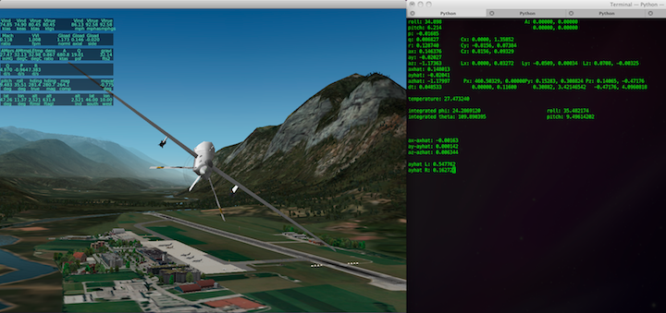
Main Objectives
Given an aircraft model, simulate aircraft state
Visualize state and behavior using FlightGear and X-Plane 10 in the future
Create a test bed for future aircraft and missions

Slide 43
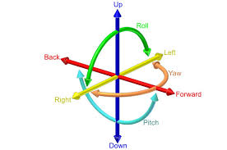
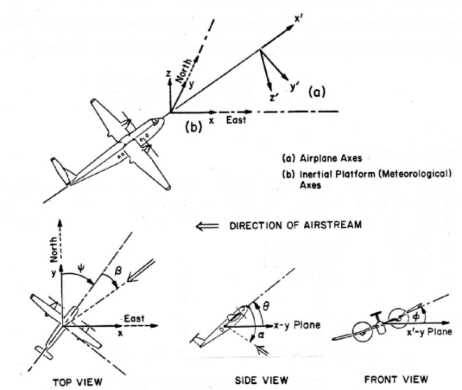
Aircraft Model
6 Degree of Freedom Aircraft Model
Models the state of the aircraft in response to control surface deflection
Modular – Can change initial values and aircraft properties
Contains pan/tilt camera model
State calculations are based off of aerodynamic, propulsion, geometric, payload, environmental, and simulation constants.

Slide 44
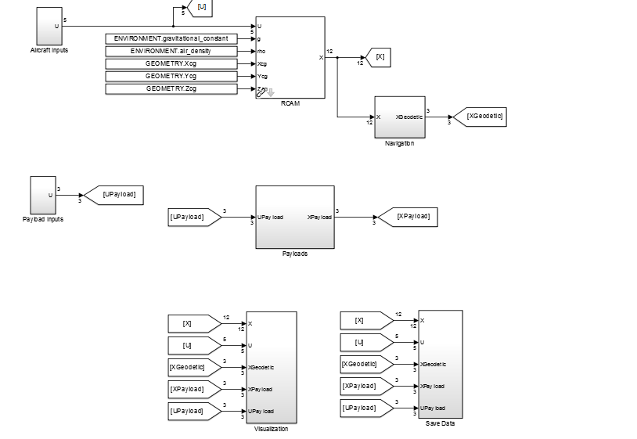
Simulation Environment
Uses Matlab/Simulink to run and simulate the behavior of the aircraft
Matlab/Simulink is also used to take data and plot the response of the aircraft
Aircraft state and camera orientation can be controlled via joystick or set to a generic pattern in Matlab
Utilizes “Aerospace Blockset” to communicate w/ joystick

Slide 45
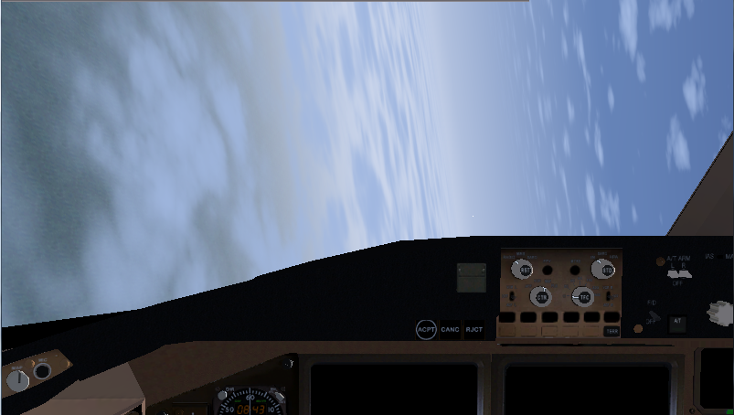
State Visualization
Uses FlightGear v2.12 as a visualization tool.
FlightGear receives signals from Simulink and carries out the simulation

Slide 46
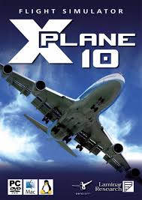
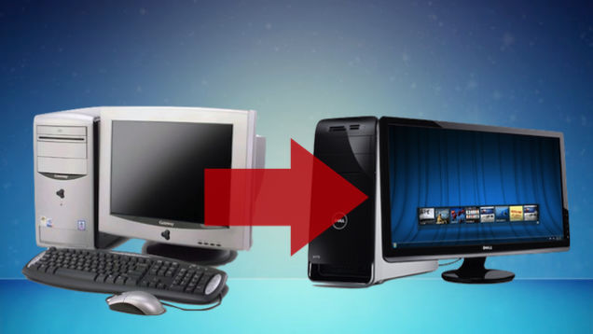
Goals
Use X-Plane 10 as the visualization tool
Verify procedure on other computers

Slide 47
Outline
Introduction (Chris Lum
Systems overview (Al Creigh)
Software modifications
Mission Planner modifications (Keisuke Tsujita)
Pixhawk modifications (Gage Winde)
Orbit controller design (Dai Tsukada)
CONDOR camera system (Brendan Doyle Wade)
Image processing
Computer vision algorithms (Matthew Jones)
Image processing framework (Henry Qin, Ryan Valach, Justin Taft)
Aircraft simulation environment (Daniel Ablog)
Conclusions and discussion (Chris Lum)

Slide 48
Next Steps
Finalize orbit controller algorithm.
Port from Matlab/Simulink to Pixhawk.
Modify Mission Planner for custom mission.
Continue development of image processing algorithms.
Conduct ground testing and trials
Establish UAS test range in Sunnyside, WA.
Obtain FAA COA for flight operations.
University of Washington
48

